Slide 1


Mid Campaign Measurement Analysis

Slide 2

Measurement
OOH
Airport
Sr.No | Cities Name | Media Units | Traffic for Pre-Over all Campaign (Mn) | Interim-campaign Number (Mn)
1 | Mumbai | 10 | 6.22 | 3.11
2 | Bengaluru | 2 | 1.61 | 0.94
3. | Chennai | 2 | 1.62 | 0.68
4. | Ahmedabad | 2 | 1.22 | 0.41
5. | Gurugram | 2 | 1.42 | 0.59
6. | Jaipur | 2 | 0.95 | 0.56
7. | Pune | 2 | 0.71 | 0.42
8. | Hyderabad | 1 | 0.74 | 0.43
9. | Kolkata | 3 | 1.07 | 0.45
Total |  | 26 | 15.56 | 7.73
Sr.No | Cities Name | Media Units | October Footfall as per Campaign duration in (Mn) | December Expected footfall in (Mn)
1 | Mumbai | 57 | 1.47 | 1.65 E
2 | Delhi | 41 | 2.19 | 2.34 E
3. | Bengaluru | 12 | 0.28 | 0.31 E
4. | Chennai | 14 | 0.63 | 0.65 E
5. | Chandigarh | 3 | 0.15 | 0.16 E
Total |  | 127 | 4.72 | 5.1 E
Start Date : 12 Dec – Date : 18 Dec 2024
Airport Traffic Source : Airport Authority India

Slide 3
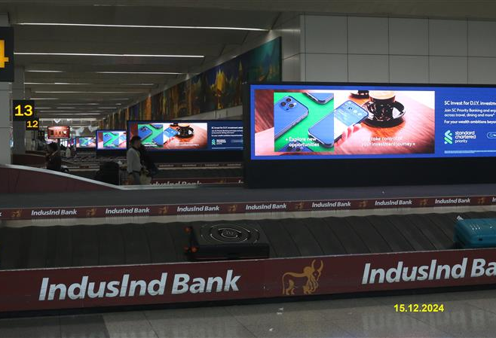
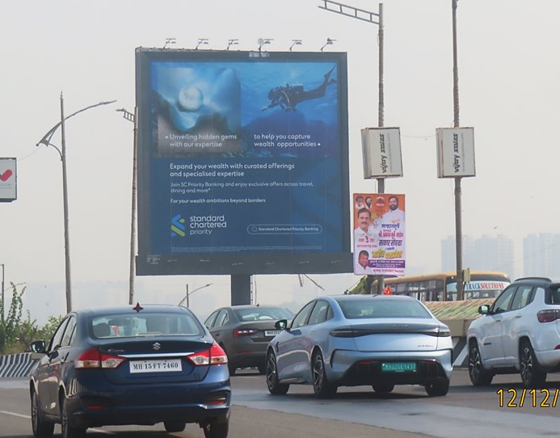
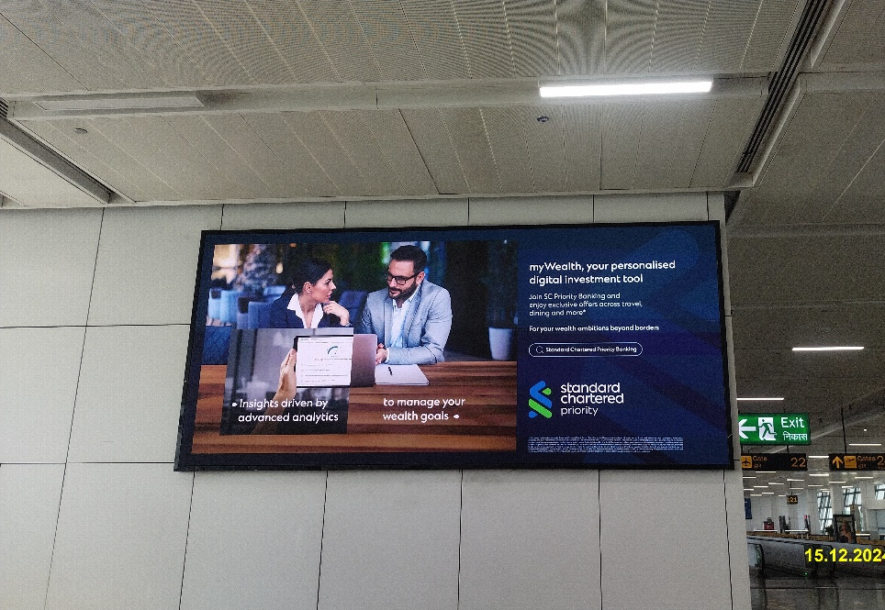
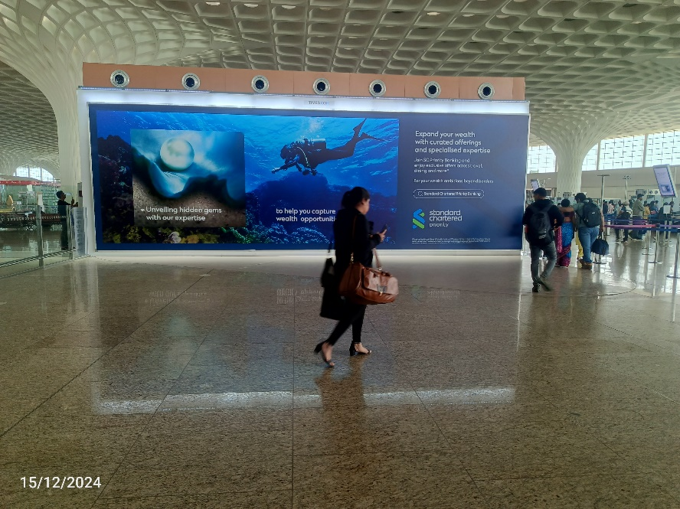
OOH Estimation
1 | Impression in Mn | 16
2 | Unique Reach in Mn | 3.87
3. | Average Frequency | 4
Value Addition
Outdoor
Hyderabad 1 Unit for Rs.0.27 Mn
Kolkata 3 Units for Rs.0.16 Mn
Airport
Delhi 24 Units for Rs.0.47 Mn
Bengaluru 5 Units for Rs.0.17 Mn
Total Value Addition worth Rs 1.07 Mn

